Slide 1
Designing an aircraft tracking datastore
Hellmar Becker

Slide 2
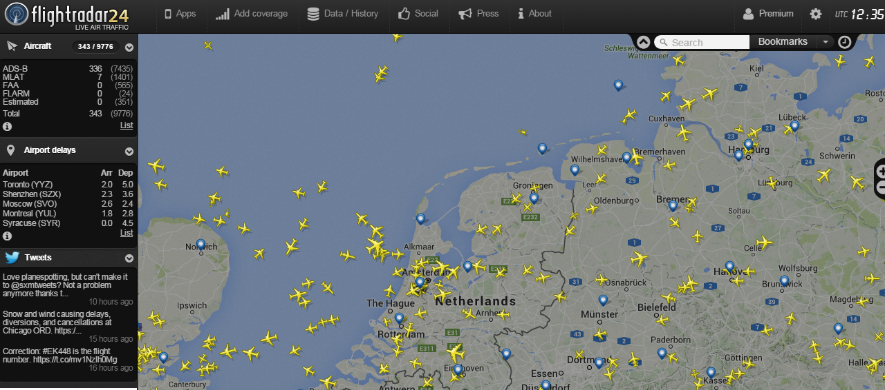
Starting point
Sites like flightradar24.com show the live position and heading of every commercial aircraft in a region. How cool is that?

Slide 3
Data collection
Each aircraft transmits its position and identity data continuously at 1090 MHz

